Slide 1

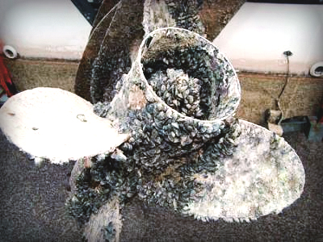
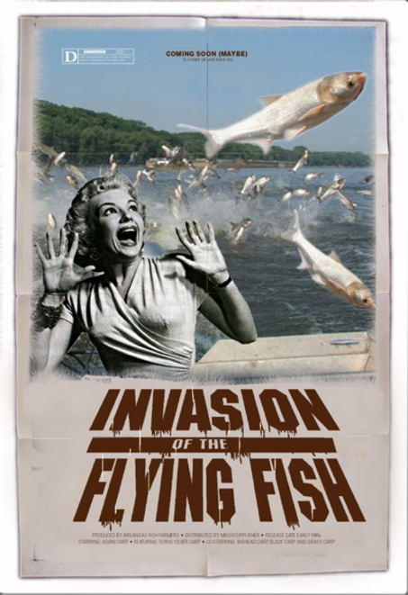
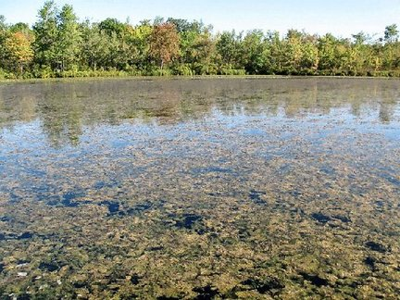
Invasive Species
Sgt. Carl Klein
Washington Department of Fish and Wildlife

Slide 2
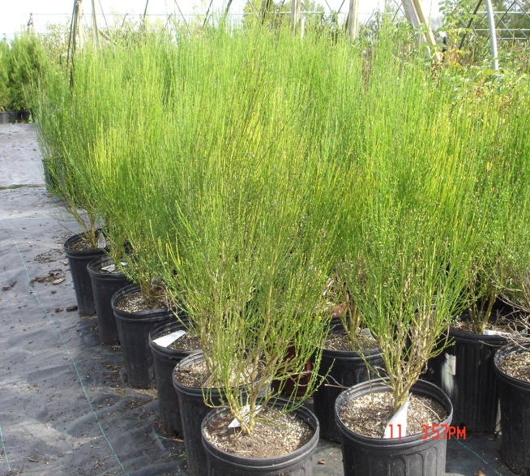
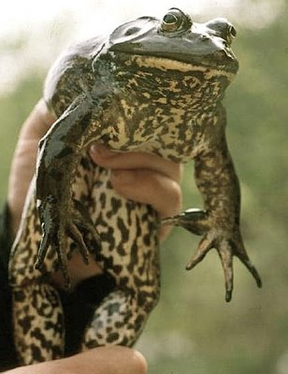
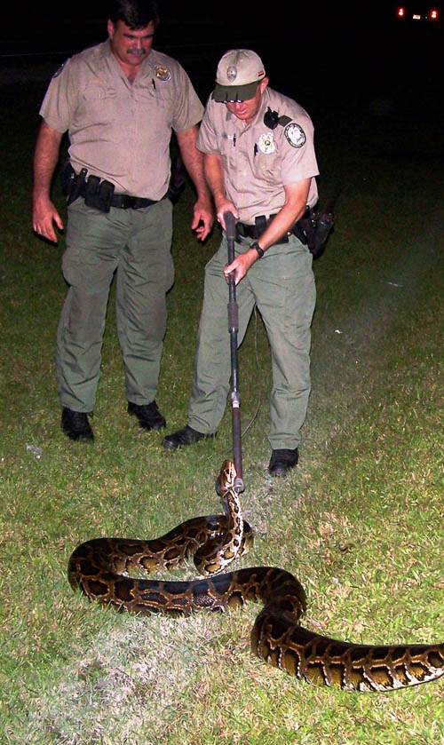
What is an Invasive Species?
Spread by Humans
Fast Growth
Rapid Reproduction
Highly Adaptable
Outcompetes with native species
Invaded other locations

Slide 3
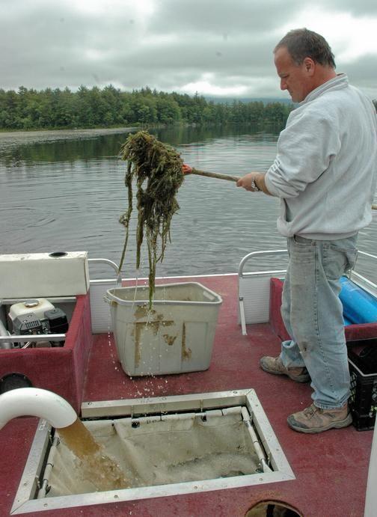
So how did they get here?

Slide 4
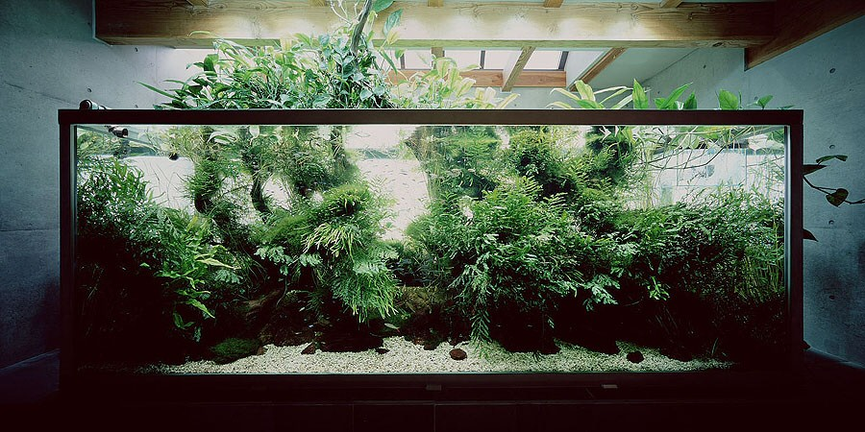
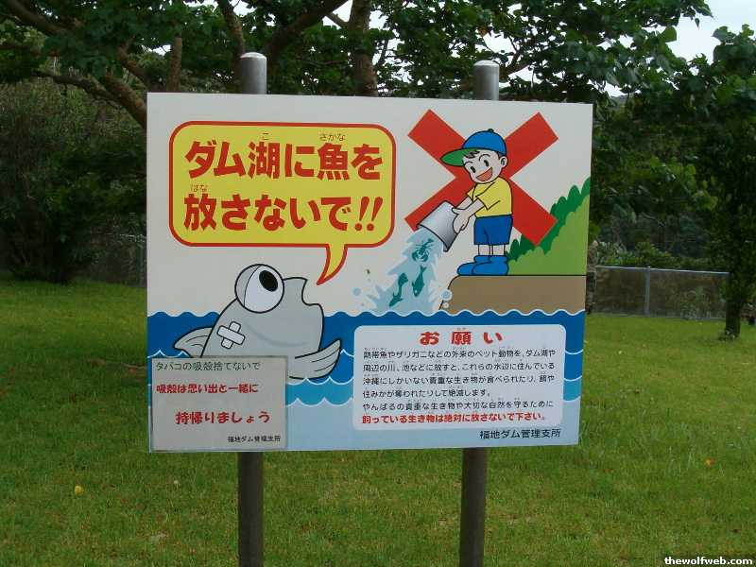
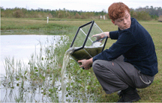
Notes:
People have dumped unwanted aquariums

Slide 5
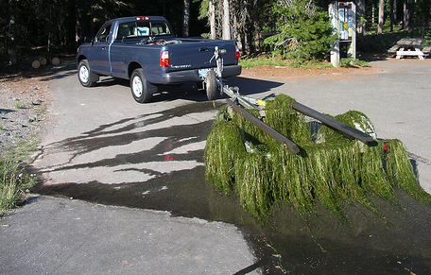
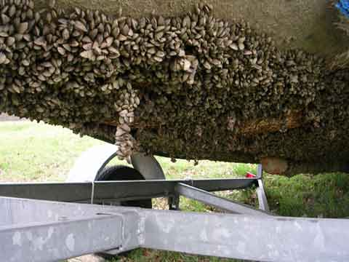
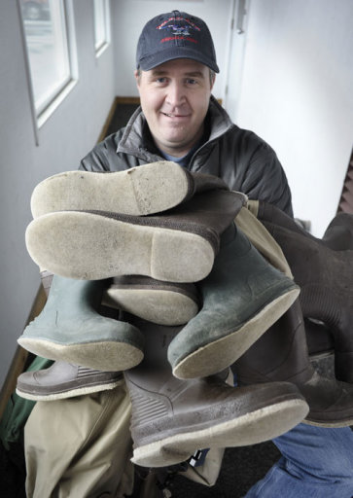
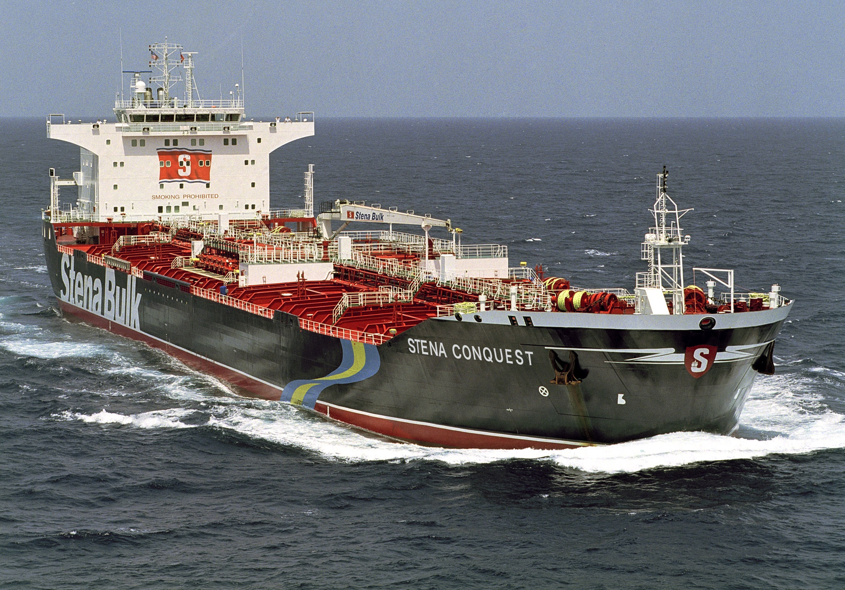
Notes:
They attach themselves and we move them

Slide 6
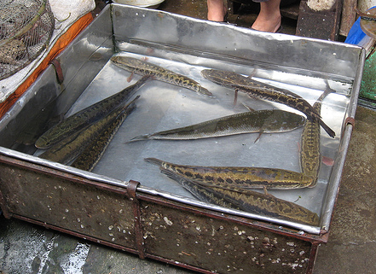
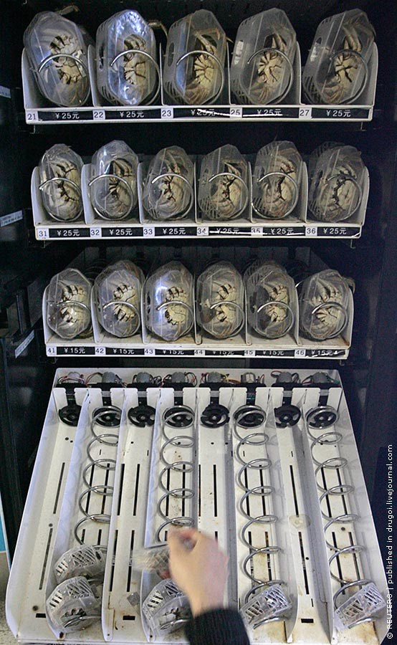
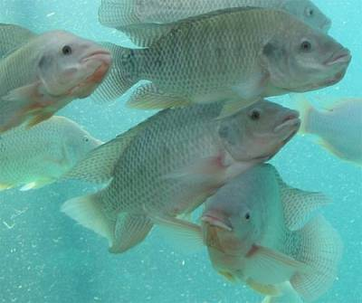
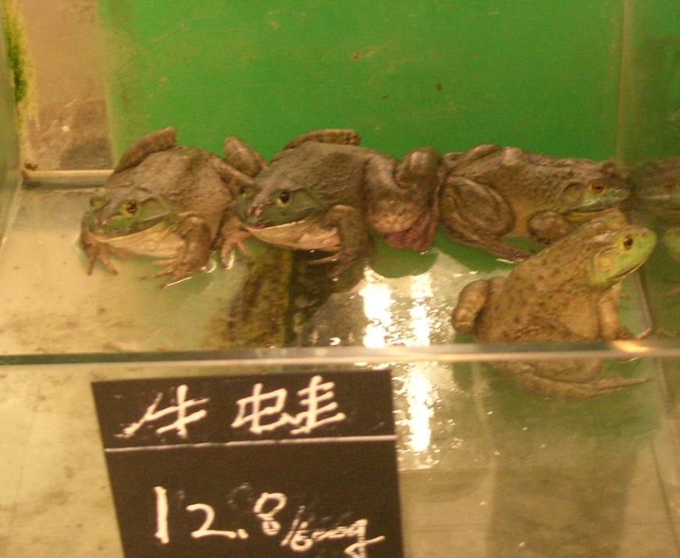
Notes:
People brought them over as food and they were released so that they didn’t have to be purchased.

Slide 7
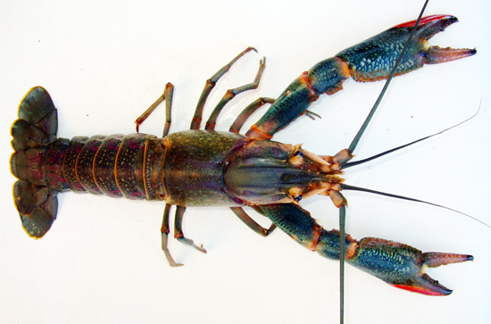
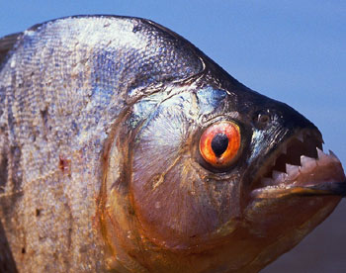
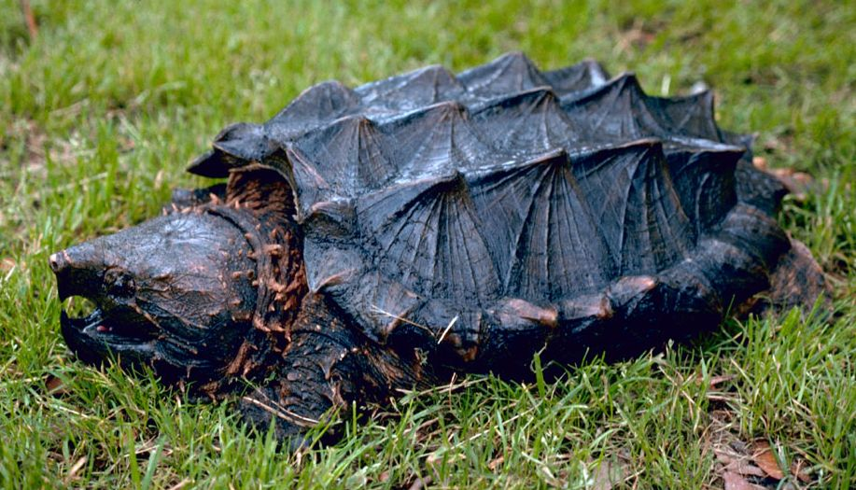
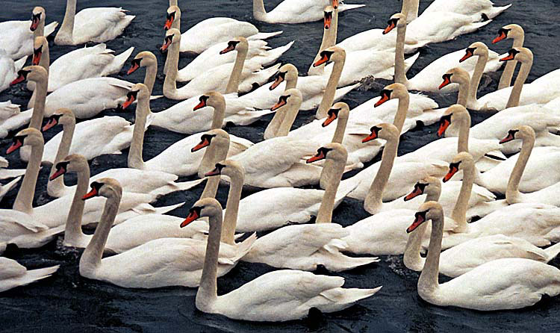
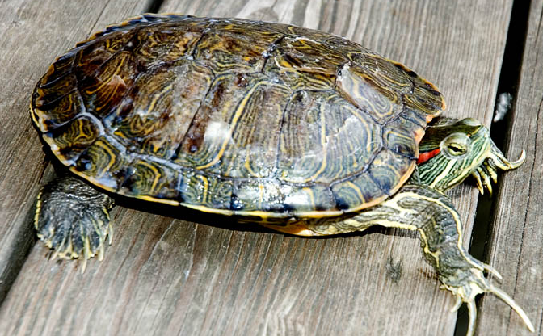
Notes:
We thought they made good pets and they either escaped or we let them go.

Slide 8
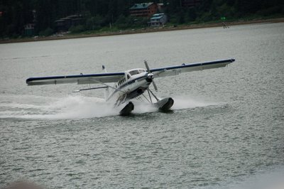
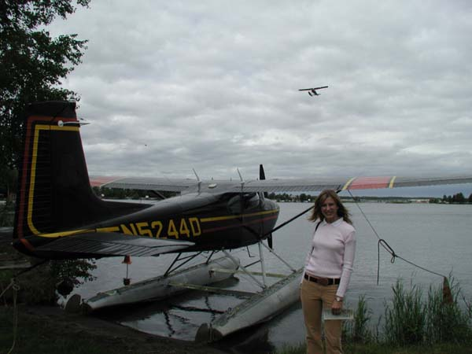
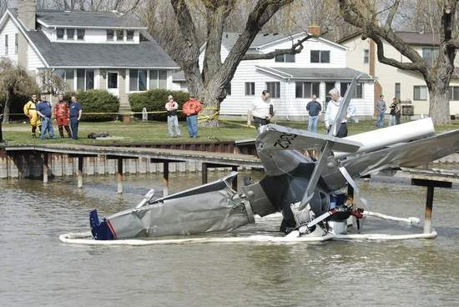
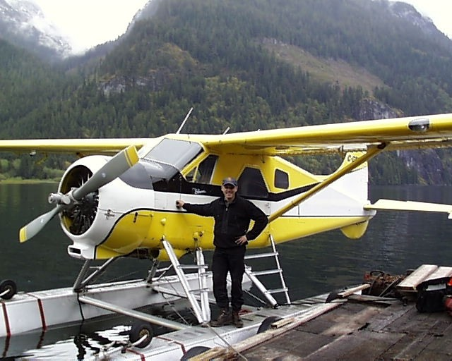
Notes:
We fly them in accidentally.

Slide 9
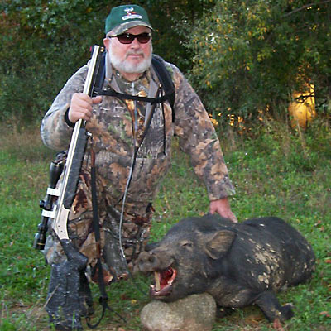
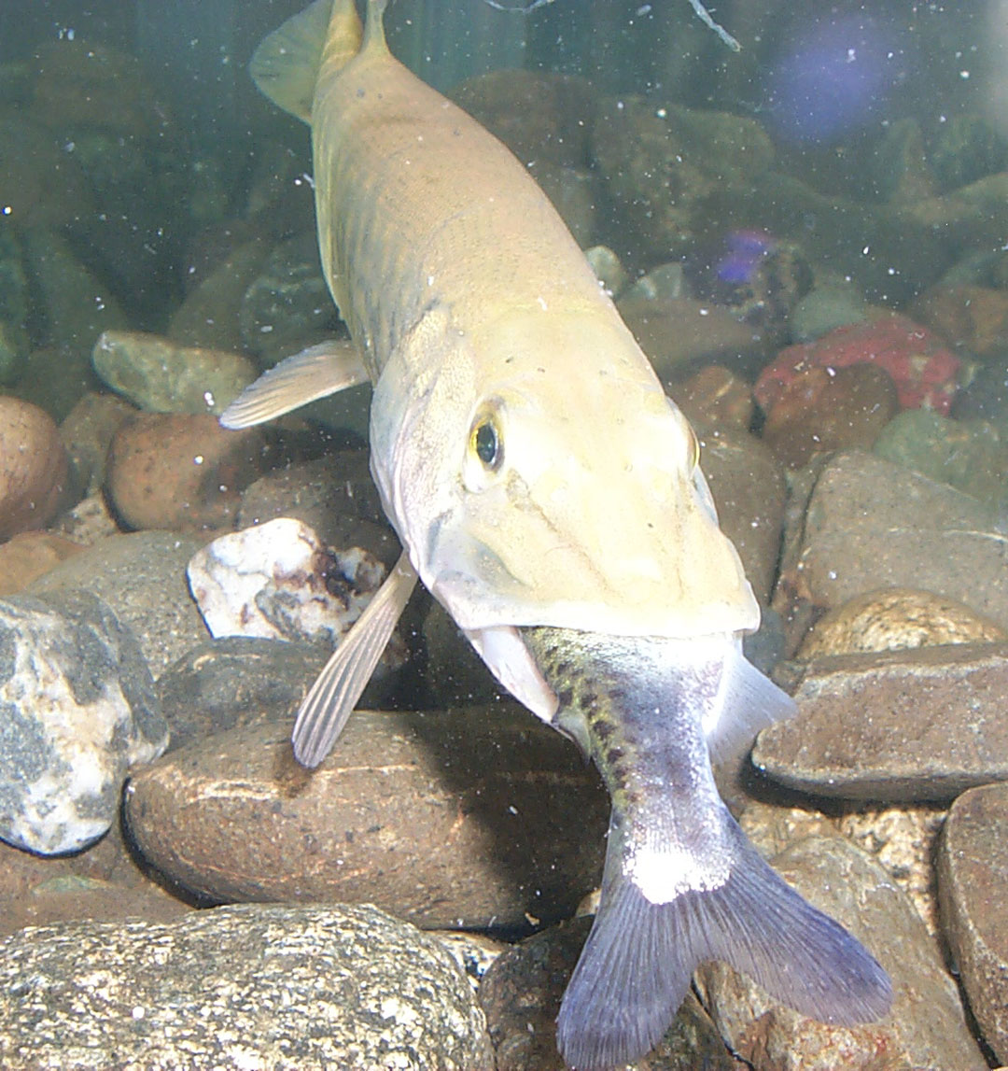
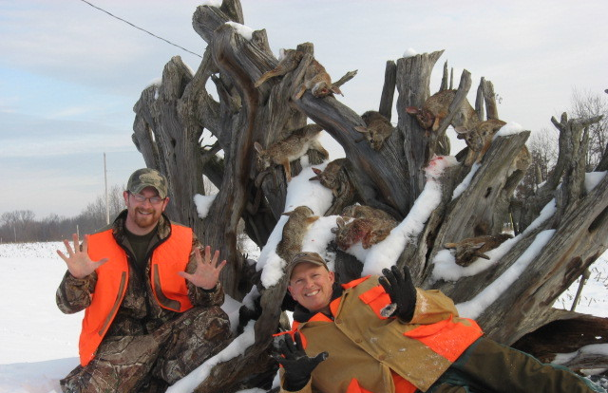
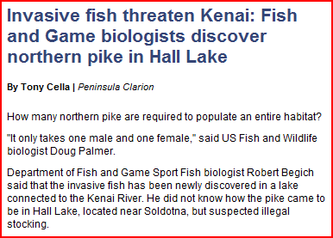

Slide 10
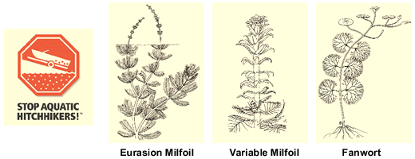
INVASIVE SPECIES OF CONCERN

Slide 11
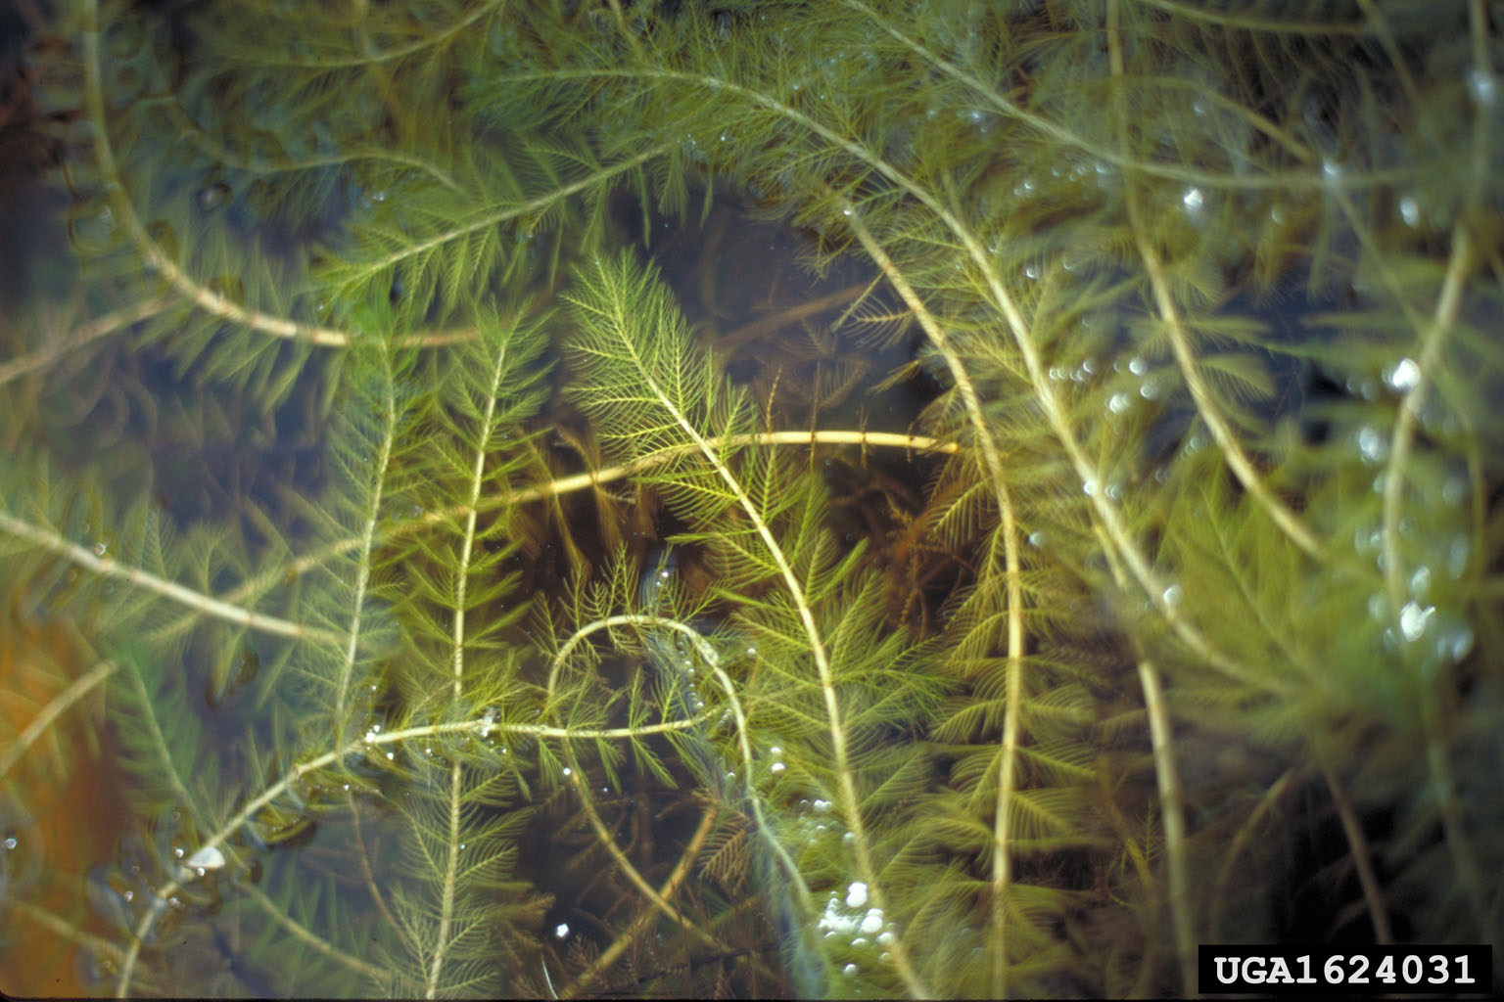
Eurasian Water Milfoil
Native to Europe & Asia
Was once a commonly sold Aquarium plant
Spreads by naturally by fragmentation (currents/waves)
Overland transport via boats, trailers, fishing gear, etc.
Grows thick mats in waters
Eradication is nearly impossible
Quickly takes over lakes and rivers, which can prevent boating, fishing and can make swimming deadly!

Slide 12
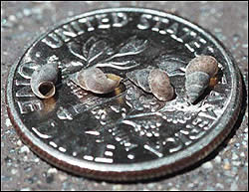
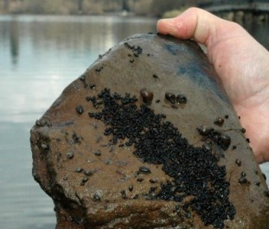
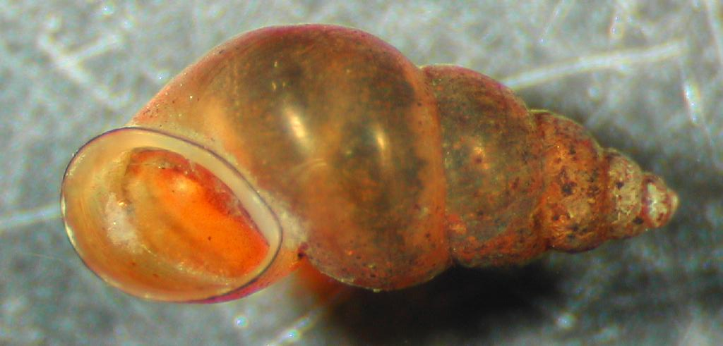
New Zealand Mud Snails
Established and Controlled (For Now)
Brown to black in color, 5-6 mm in size, sharp conical shell that has 5-6 spirals
“The Perfect Aquatic Invader” -Takes only one, reproduce by parthenogenesis.
Tiny, easily transported most often on “fishing equipment”.
Can live out of water a long time (depends on condition).
No natural predators.

Slide 13
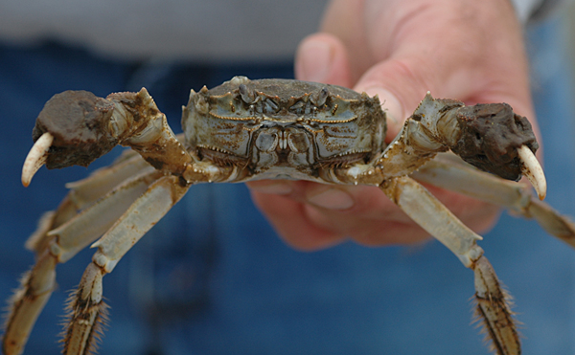
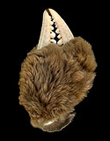
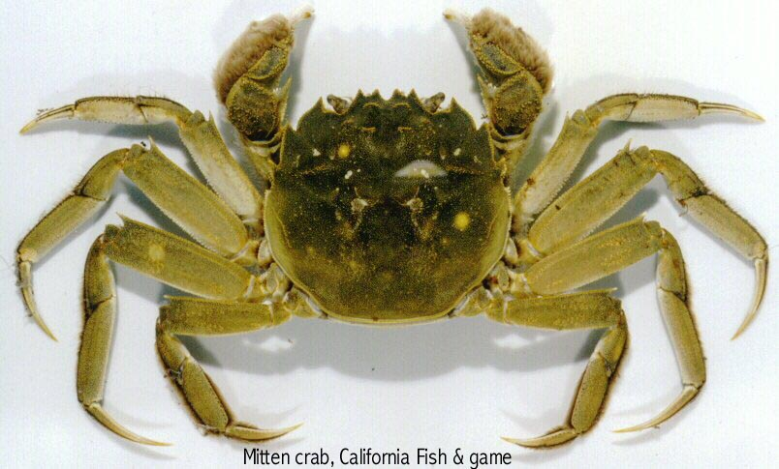
Mitten Crab (not established in PNW, yet!)
Up to 3 inches across carapace.
Native to the Yellow Sea (Gulf Between China and Korea).
Catadromous (spawns in salt water and rears in fresh water)
Omnivorous - juveniles eat mostly vegetation then diet turns predatory as they grow.
Cause major bank and levee erosion by burrowing.
Currently on California coast
Two possible ways that they were introduced- Ballast water or Intentional Introduction.
One found in Columbia River in 1997.

Slide 14
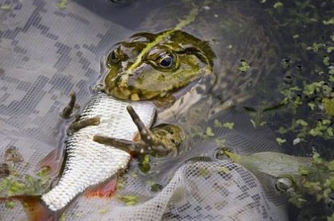
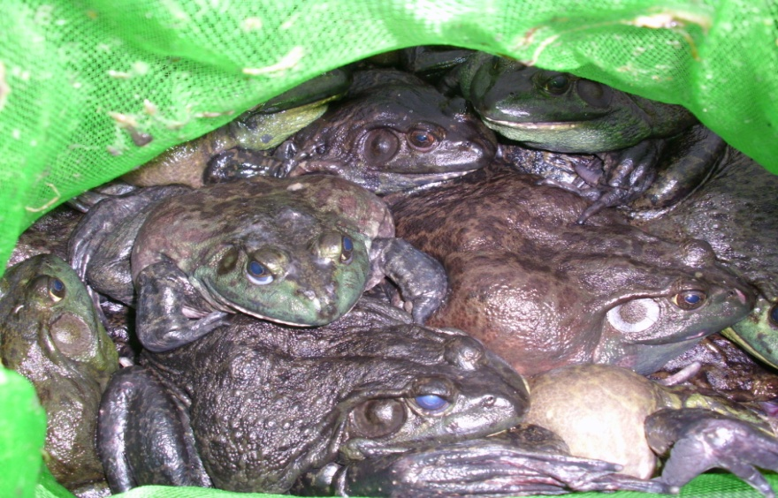
Bullfrogs ESTABLISHED
Responsible for decline in Oregon Spotted Frog, Leopard Frog, and Western Pond Turtles
Originally introduced for consumptive use
Voracious predator on native species
Notes:
They are partially responsible for decline in oregon spotted frog, leopard frog, and western pond turtles

Slide 15
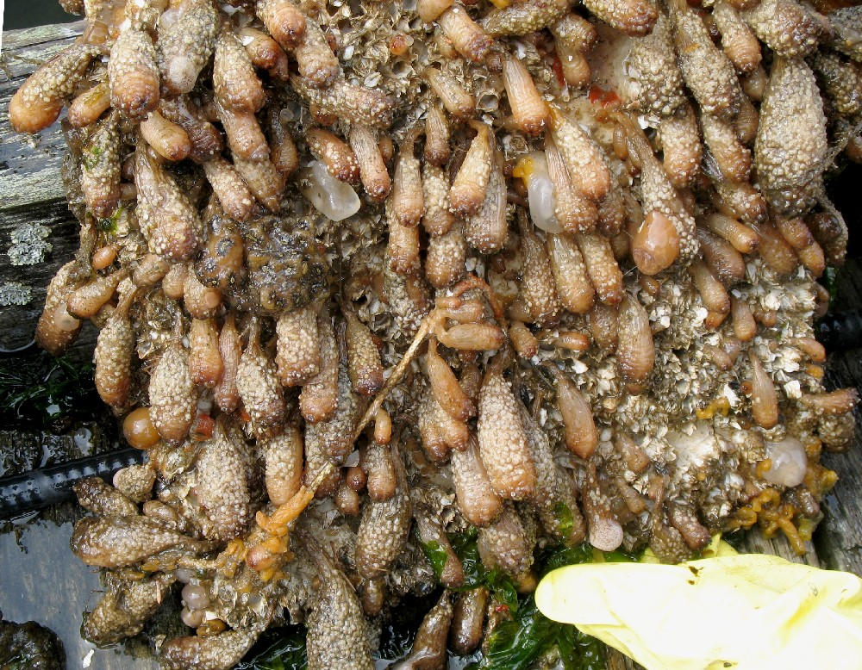
Tunicates (Three Species)
Reproduces every 24 Hours
Outcompetes native organisms
Threatens our commercial shellfish harvests
Can spread via recreational watercraft or bilge waters

Slide 16
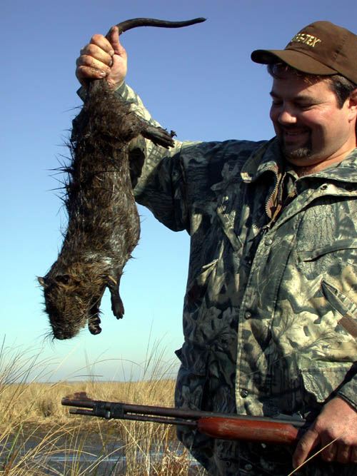
Nutria ESTABLISHED
Introduced for fur trade
Responsible for destruction of wetlands
Weakened levees that failed during Katrina
Also host to parasites that effects humans

Slide 17
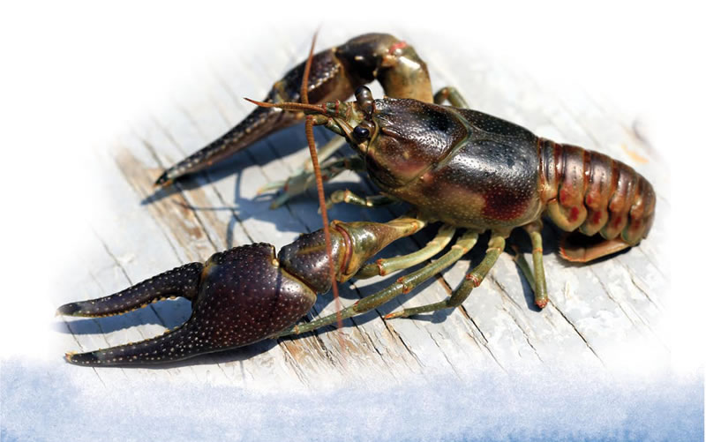
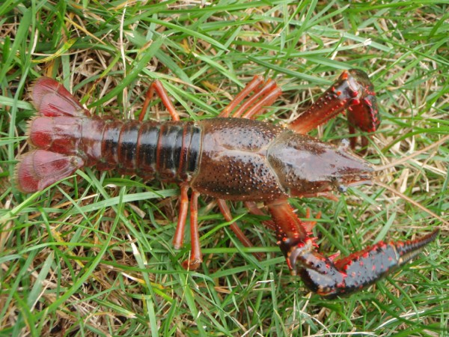
Rusty/Red Swamp Crayfish ESTABLISHED
Introduced via aquaria/bait release
Destroys native vegetation
Impacts habitat by burrowing into mud increasing erosion

Slide 18
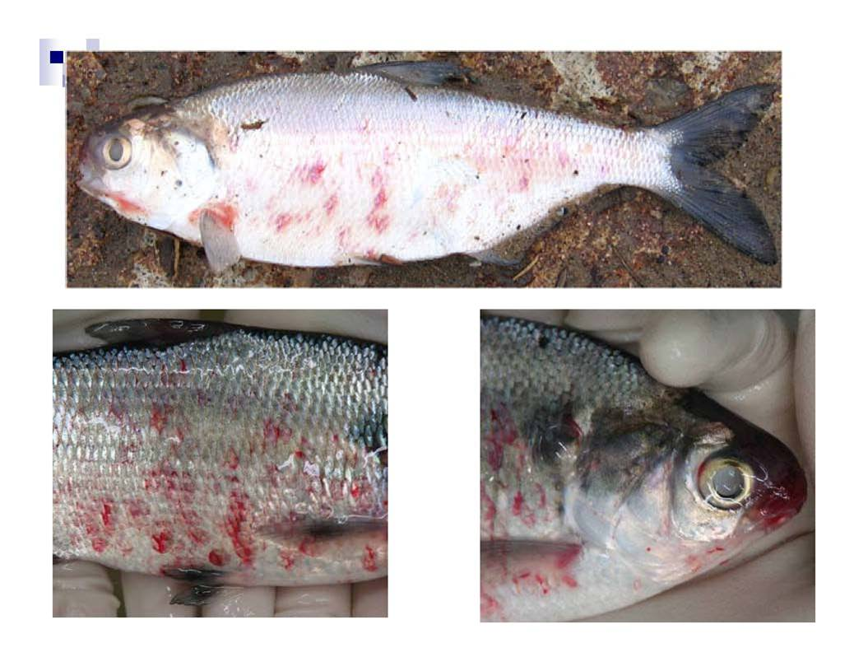
MICROSOPIC INVADERS
VHS Virus
Green Crab Larvae
Dreissenidae Veligers
Water Fleas

Slide 19

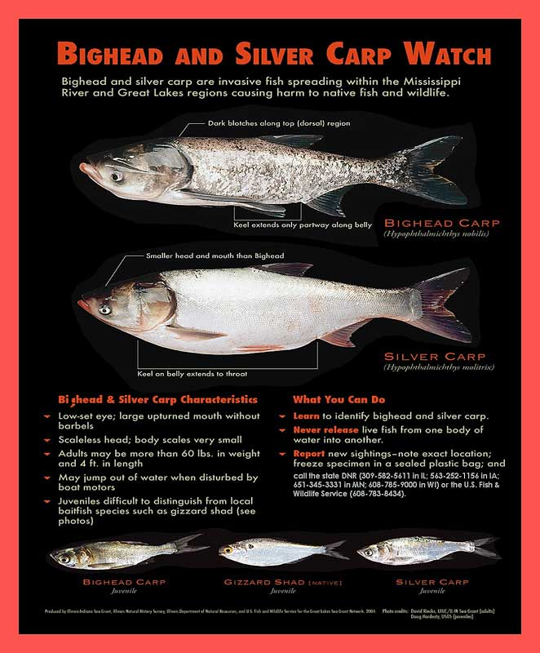
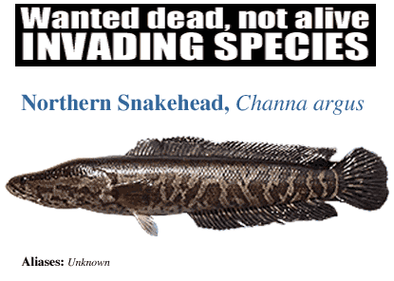
LETS MAKE SURE THEY DON’T MAKE IT
THESE ARE ON THEIR
WAY TO WASHINGTON

Slide 20
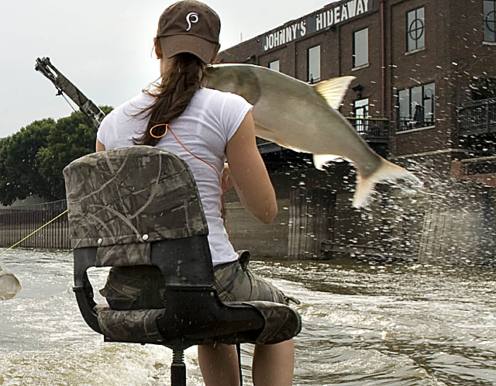
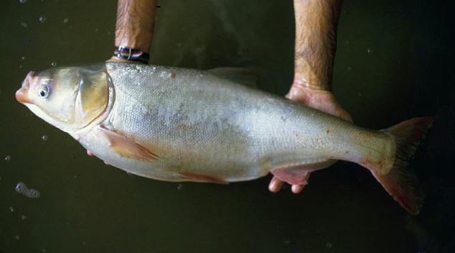
Asian Carp
Black, Silver & Big head
Up to 100lbs
Reproduce Rapidly
Very adaptable with a High probability of being introduced into Washington.
Intentionally introduced in Arkansas for aquaculture use. (they escaped)
Can be carriers of parasites and pathogens
Potential for Human Physical Damage

Slide 21

Northern Snakehead
Channa argus
Grows up to 47 inches, 15 pounds
Native to Siberia, China and Korea
Will survive very cold winters, can survive under ice
Mostly occur in rivers, some in ponds and lakes
Federal Injurious Wildlife Species, prohibited in 36 states including Washington
Popular as aquarium animals and as a food fish

Slide 22


Northern Snakehead - Concerns
They are very predatory, will consume fish, crustaceans,
reptiles, amphibians, young birds and small mammals
Juveniles will consume insects, small crustaceans and
fry of other fish
Can disrupt entire food webs
Have no known predators in US
Host to many parasites that could affect native fish

Slide 23

Invasive Feral Hogs
NOT PRESENT
Individuals are compelled to introduce to increase “hunting” opportunity
Currently established throughout the south as well as California and Oregon
If introduced would actually severely limit hunting opportunities in order to protect populations of native species

Slide 24




Feral Hogs
HOW BAD CAN THEY BE???
They are extremely aggressive often attacking people and animals
Are often called the non-stop roto-tiller
Aggressive and expensive control measures

Slide 25


Biologic/Environmental
Damage
Disrupt the natural nutrient cycle effecting a wide range of plants and animals including humans.
Invasive species play a role in the spread of diseases such as cholera, malaria, West Nile Virus, and Bird Flu.
To compensate for the impacts of invasive species there are more restrictive regulations on how we impact the environment.

Slide 26

Introduce and Spread Disease

Slide 27



Invasive Species . . .
Are a factor in 42 percent of endangered species listings.
Cost an estimated $138 billion a year in damages and control efforts -$30 billion of which is spent on invasive plant species.
Reduce recreational opportunities such as fishing, hunting, hiking, boating and wildlife viewing

Slide 28

This is now what most of the beaches on the Great Lakes look like (Photo from Lake Erie)
About 1.5 feet deep of mussel shells

Slide 29

FINANCIAL IMPACTS
Costs to the US are estimated to be 130 Billion Dollars Annually
US Drug War costs only 40 Billion Dollars per year

Slide 30



HOW DO WE STOP THEM FROM INVADING WASHINGTON?
Public Education through pamphlets, signage and presentations
Conducting inspections and check stations
Through the enforcement of
AIS laws

Slide 31







A variety of educational materials have been developed . . .
Fact sheets, reports, and other publications
Training programs and workshops
Exhibits and displays at Fairs and Sportsmen shows
Videos and other multi-media products

Slide 32





SIGNAGE HAS BEEN INSTRUMENTAL
With proper signage we have been able to reach our target audience at a time and place where we can have the most impact.

Slide 33


Washington Signs
Remind boaters to clean vessels prior to leaving launch
Informs the public of the presence of AIS in a particular waterbody

Slide 34

So They Are Mobile, Now what do we do?

Slide 35


CHECKSTATION / Inspection Authority
Fish and Wildlife Officers were given special authority by the Washington Legislator to conduct roadside check stations to check specifically for Aquatic Invasive Species.

Slide 36


INFORMATION ON CHECKSTATIONS
All Check Stations are MANDATORY
Most inspections of recreational watercraft only last 3-5 Minutes
Public is immune from AIS Laws at check stations if all department directives are followed
Can be found on various roadways including highways or at boat launches
WSP Inspects all commercially hauled vessels at various Port of Entries and Weigh Stations
Designed to be educational/informational in nature

Slide 37

How you can Help Prevent the Spread of Invasive Species
Remove visible plants and animals from your boat, trailer, and any other equipment before leaving any waterbody
Drain water from the motor, live well, bilge, and transom wells before leaving the ramp
Dispose of bait away from water

Slide 38

INDUSTRIES AFFECTED BY INVASIVE SPECIES REGULATIONS
PET TRADE
SHIPPING/DISTRIBUTION
FLOAT PLANES
MINING
AGRICULTURE
FISHING
HUNTING
Many Others…

Slide 39

HOW YOUR INDUSTRY IS AFFECTED BY INVASIVE SPECIES
Boaters and other water users are a pathway allowing some of these species to spread rapidly.
This spread has led to more restrictive legislation, increased fees, limited access to certain water bodies.

Slide 40
Industry’s Potential Role in Preventing Invasive Species
State doesn’t have the funding to check every boat.
Industry can put measures in place to reduce the threat of spreading different species.
Additional measures from private industry will also help educate the public.

Slide 41

SOLUTIONS TO INVASIVE SPECIES PROBLEM
Requiring equipment/vessels to be decontaminated.
Availability of decontamination.
Awareness of the problem and what can be done.

Slide 42

ADDITIONAL TRAINING AVAILABLE
WDFW is available to provide additional training to certify employees at:
Invasive Species Inspections
Decontamination

Slide 43
Questions?

Slide 44
Contact Information
WDFW AIS Statewide Enforcement Sgt.
Carl Klein- (360)902-2346
Carl.Klein@dfw.wa.gov

